Slide 1
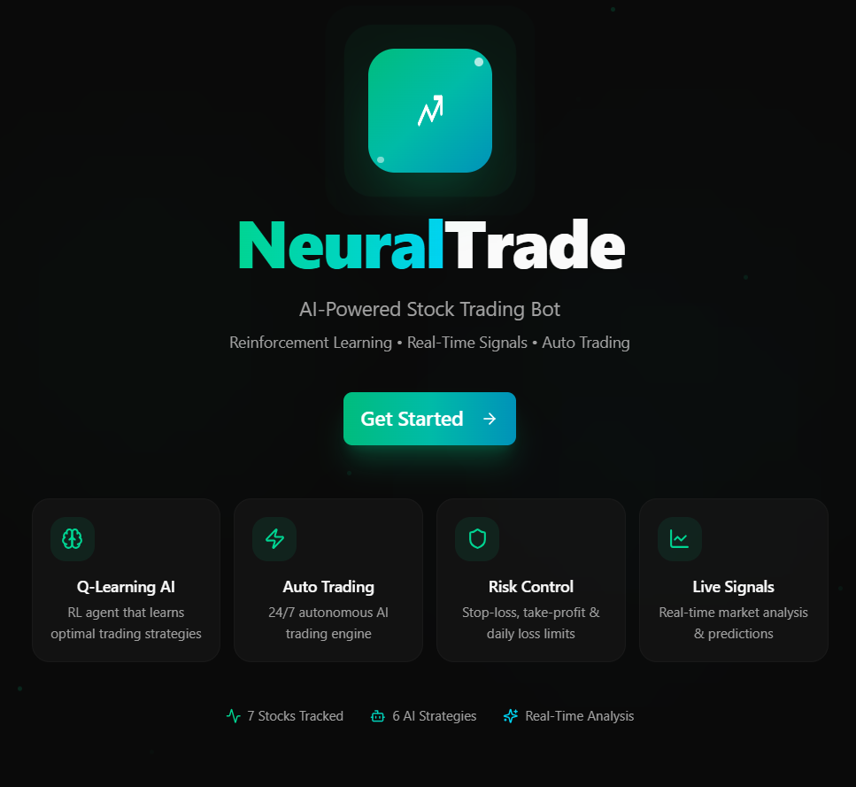
AI STOCK TRADING BOT
Powered By Reinforcenment Learning

Slide 2

TANIA MANSOOR KHAN UL-BSITM-A-23-27
AI POWERED STOCK TRADING BOT
SUBMITTED BY
SUBMITTED TO
SIR FAISAL HAFEEZ
SUBJECT
ARTIFICIAL INTELLEGENCE

Slide 3
Table of Content
Introduction | Objectives
Key Features | Working
Future Enhancements | System Workflow
Technologies Used | AI & Machine Learning Model
Advantages | Limitations
Results | Conclusion

Slide 4


INTRODUCTION
An AI Stock Trading Bot is an intelligent software system that uses Artificial Intelligence (AI), Machine Learning (ML), and market data analysis to automatically monitor stock markets, predict price movements, generate trading signals, and execute trades.
The bot analyzes factors such as:
Real-time stock prices
Historical market data
Technical indicators
Financial news
Market trends
Based on this analysis, it can generate BUY, SELL, or HOLD recommendations and, in some cases, execute trades automatically.

Slide 5
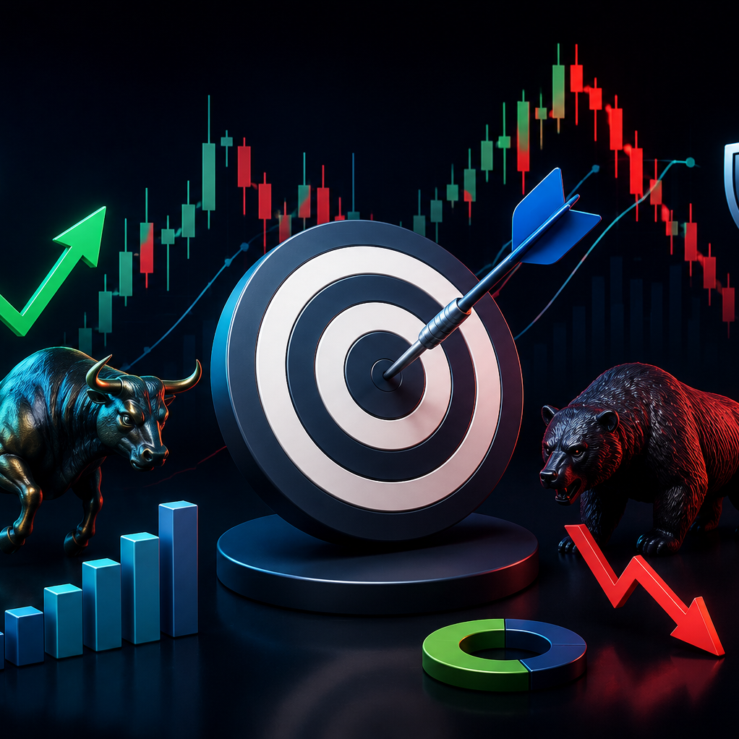
Objectives
of the project

Slide 6

OBJECTIVE
Goals of the Project
To develop an AI-powered stock trading system that analyzes market data, predicts trading opportunities, generates intelligent trading signals, and assists users in making informed investment decisions.

Slide 7



WORKING
A stock trading bot works in 4 main steps:
1. Data Collection
It collects real-time and historical market data such as:
Trading volume
Stock prices (Open, High, Low, Close)
Market news
Financial reports
2. Data Analysis
It analyzes data using:
Technical indicators (RSI, MACD, Bollinger Bands)
Machine Learning models
AI prediction systems

Slide 8


3. Signal Generation
Based on analysis, the bot generates signals:
BUY signal → stock expected to rise
SELL signal → stock expected to fall
HOLD signal → no clear trend
4. Trade Execution
The bot can:
Suggest trades to users
Or automatically execute trades (in advanced systems)

Slide 9
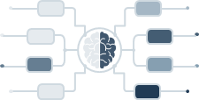
KEY FEATURES
01
02
03
05
07
08
AI Trading Signals
Portfolio Management
Auto Trading
04
06
AI Chat Assistant
Backtesting
Notifications
09
Technical Indicators
RL Model Training
Login\Registration

Slide 10
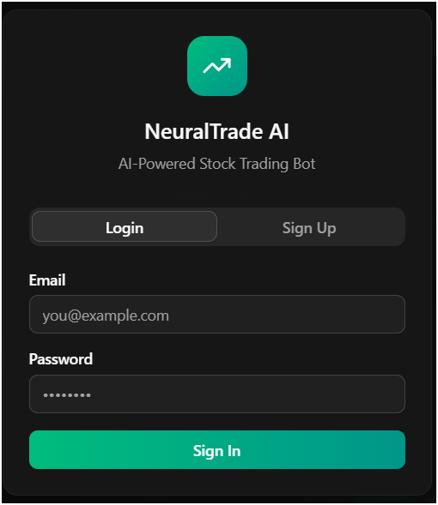

Login & Registration
User account creation (Sign Up)
Secure user authentication (Login)
Protects personal and trading data
Personalized user dashboard
Authorized access to the system only

Slide 11
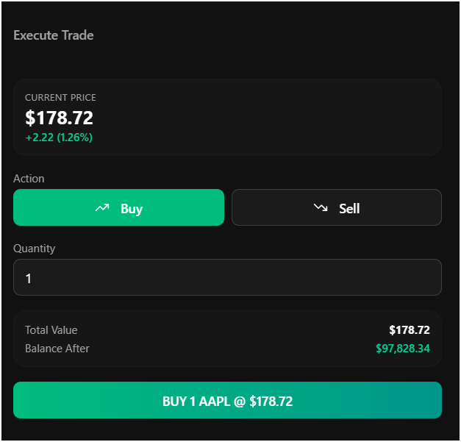
AI Trading Signals (BUY / SELL / HOLD)
The AI analyzes market data and generates trading signals:
BUY → Stock is expected to increase in value
SELL → Stock is expected to decrease in value
HOLD → No clear trading opportunity
These signals help guide trading decisions.

Slide 12
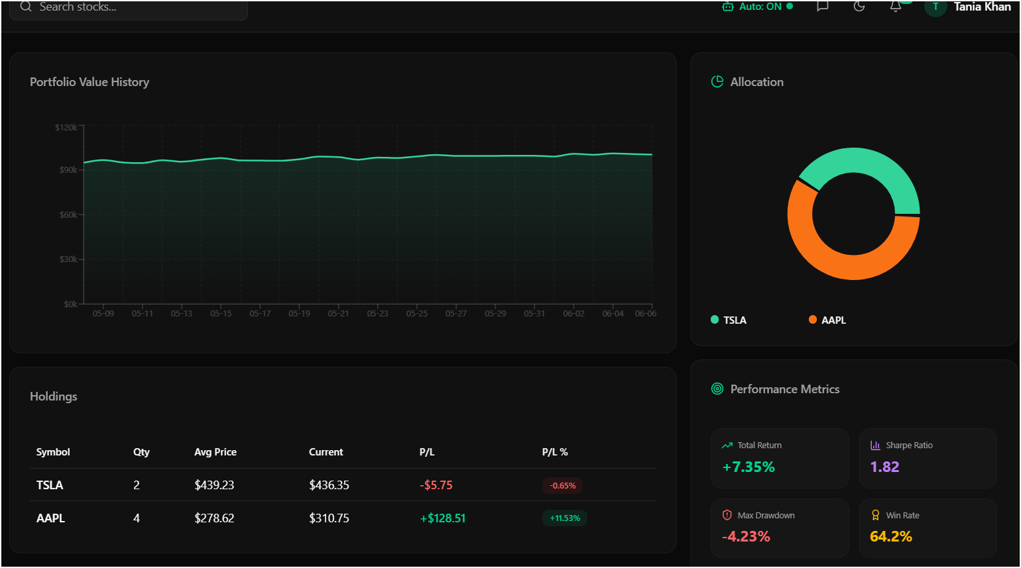
Portfolio Management
Manages and tracks user investments:
Total portfolio value
Profit and loss (P&L)
Asset distribution
Risk analysis
It helps users manage their investments efficiently

Slide 13
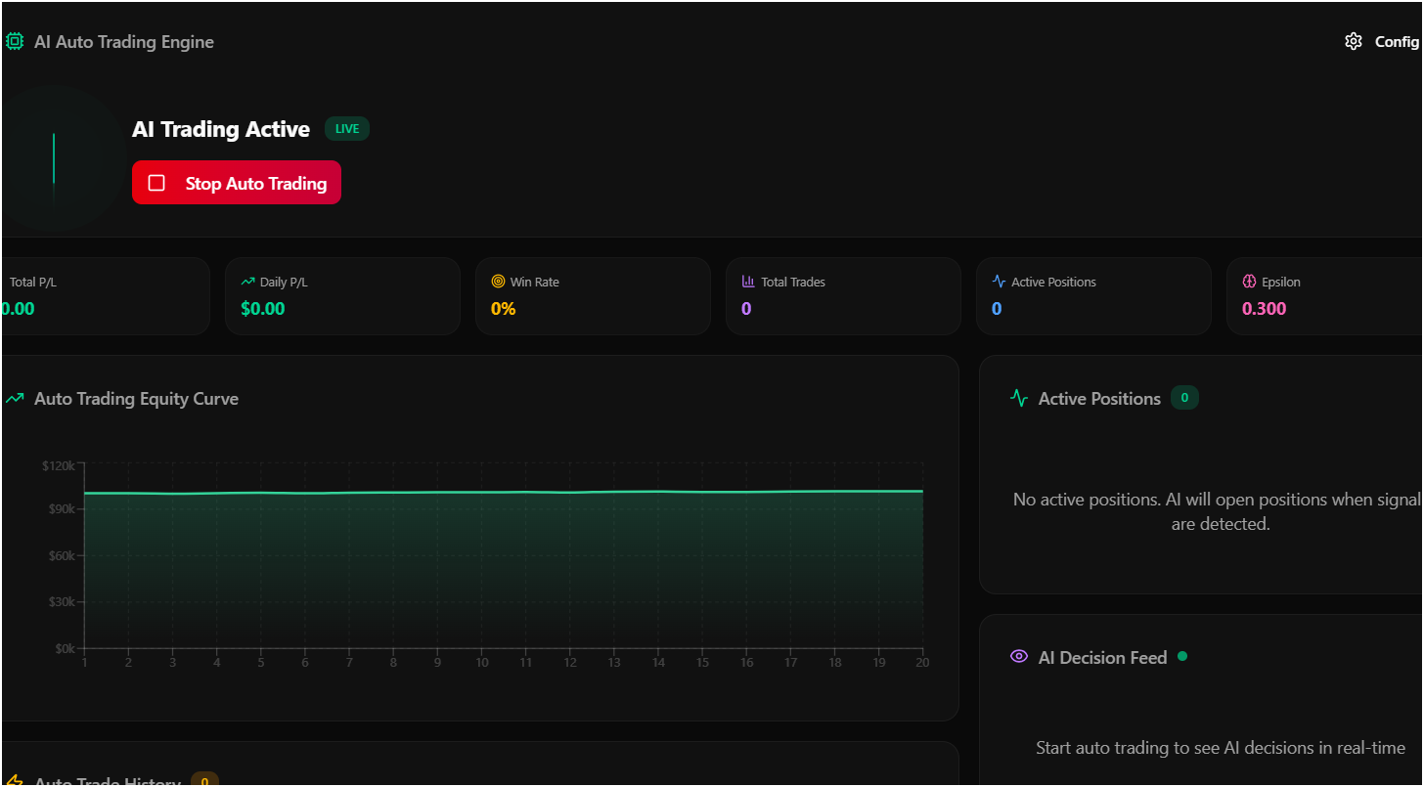
Auto Trading (Simulation Mode)
A virtual trading environment where:
Trades are executed automatically
No real money is used
Performance is tested safely
This is used for learning and strategy validation.

Slide 14
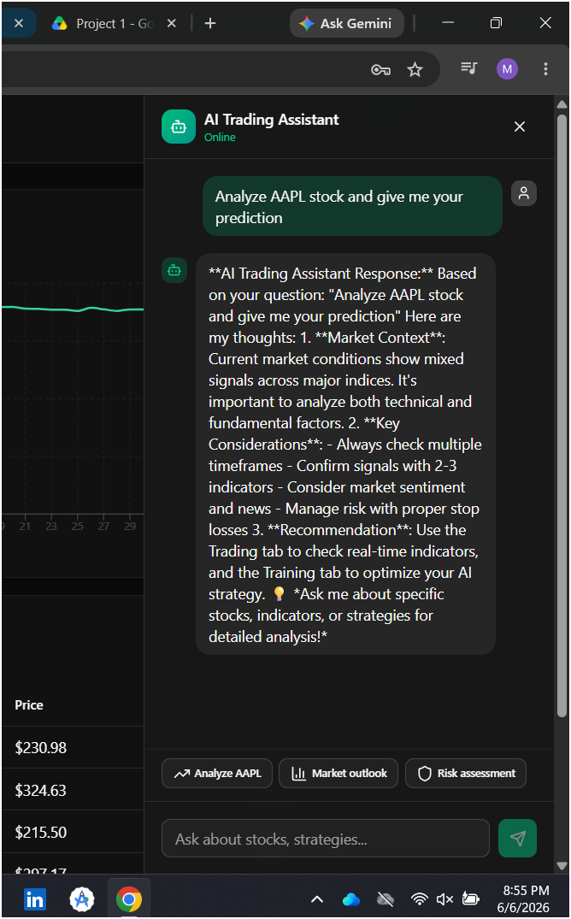
AI Chat Assistant
An intelligent assistant that:
Answers trading-related questions
Explains market trends
Provides portfolio insights
Helps users understand signals
It improves user interaction with the system

Slide 15
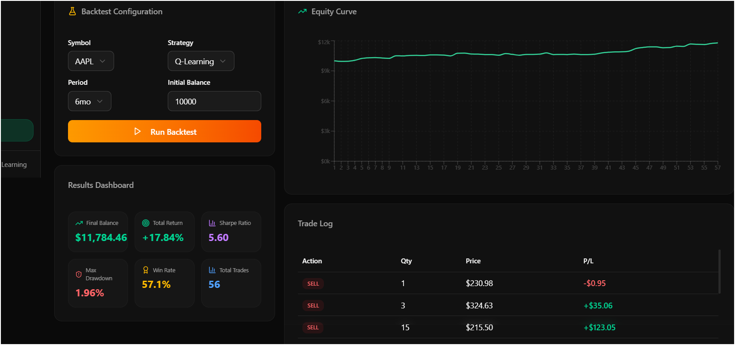
Backtesting
Tests trading strategies using historical stock market data.
Evaluates how the strategy would have performed in the past.
Measures key metrics such as profit, loss, and win rate.
Helps identify weaknesses and improve trading performance.
Reduces risk by validating strategies before live trading.

Slide 16
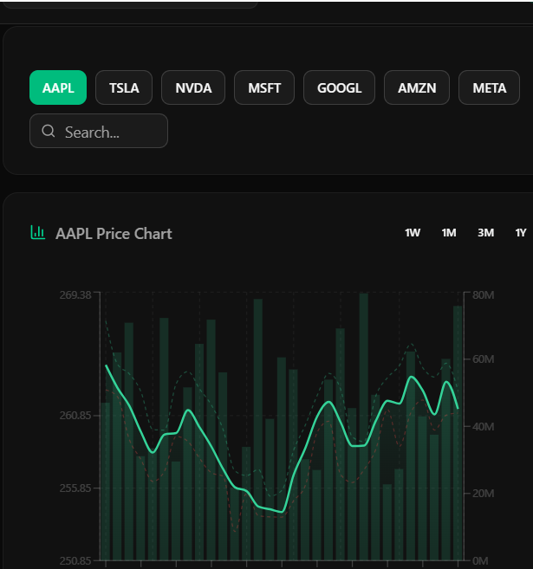
(AAPL, TSLA, NVDA, etc.)
Stock Data
The system collects real-time and historical stock market data such as:
Stock prices (Open, High, Low, Close)
Trading volume
Market trends
Financial news
Company performance data
This data is the foundation for all predictions and decisions.

Slide 17
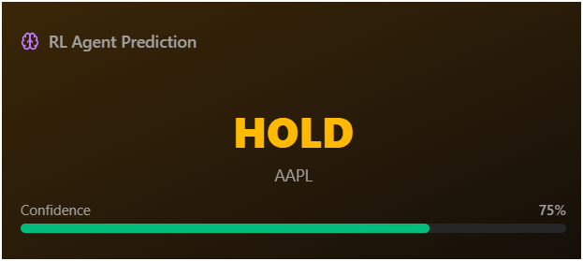
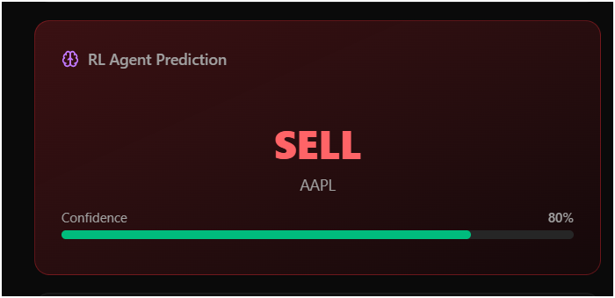
Reinforcement Learning (RL)
Uses Artificial Intelligence to learn trading strategies automatically.
The RL agent performs Buy, Sell, and Hold actions.
Receives rewards for profitable trades and penalties for losses.
Continuously improves its performance through trial and error.
Adapts to changing market conditions to maximize returns.

Slide 18
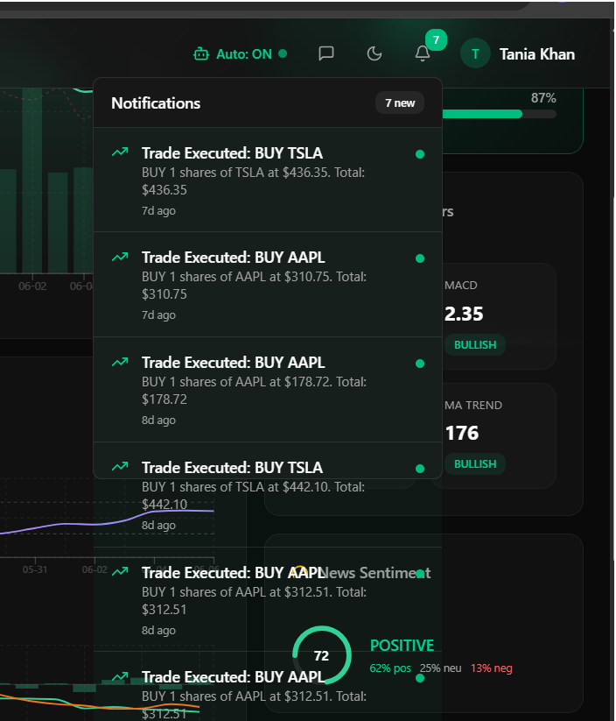
Notifications System
Sends real-time alerts to users:
1. BUY / SELL signals
2. Price changes
3. Portfolio updates
4. Risk alerts
Notifications keep users updated instantly

Slide 19
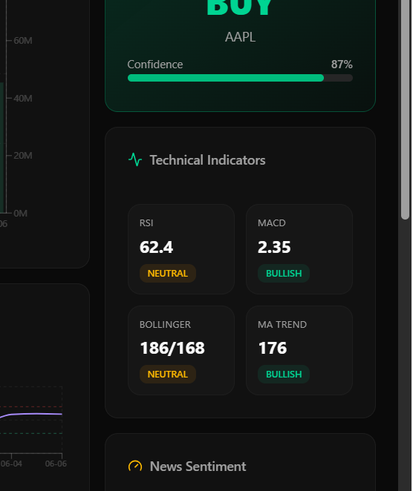
Technical Indicators (RSI, MACD, Bollinger Bands)
These are mathematical tools used for market analysis:
RSI (Relative Strength Index) → Measures overbought/oversold conditions
MACD (Moving Average Convergence Divergence) → Shows trend direction
Bollinger Bands → Measures market volatility
They help generate accurate trading signals.

Slide 20

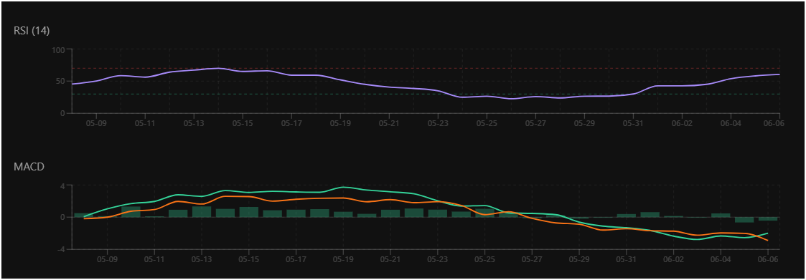
Project data
Benefits of using graphs
Easy visualization of complex data
Identifies market trends quickly
Supports better trading decisions
Tracks portfolio performance
Enhances technical analysis
Enables real-time monitoring
Visualizes AI predictions and signals
Assists in risk management
Compares multiple stocks efficiently
Improves user experience and engagement

Slide 21
Summary
An AI Stock Trading Bot combines real-time market data, AI models, technical indicators, and automation to analyze markets, generate trading signals, and help users manage investments efficiently.

Slide 22
Technologies Used
┌─────────────────────────────────────────┐
│ FRONTEND (React 19) │
│ ┌─────────┐ ┌──────────┐ ┌──────────┐ │
│ │Dashboard │ │ Trading │ │ AI Chat │ │
│ └────┬─────┘ └────┬─────┘ └────┬─────┘ │
│ │ │ │ │
│ ┌────▼─────────────▼────────────▼─────┐ │
│ │ Zustand Store + React Query │ │
│ └──────────────┬──────────────────────┘ │
│ │ fetch() │
├─────────────────┼────────────────────────┤
│ BACKEND (Next.js API) │
│ ┌──────────────▼──────────────────────┐ │
│ │ 17 API Routes (App Router) │ │
│ │ ┌──────┐ ┌──────┐ ┌─────────────┐ │ │
│ │ │Stocks│ │ RL │ │ AI Chatbot │ │ │
│ │ └──┬───┘ └──┬───┘ └──────┬──────┘ │ │
│ └─────┼────────┼────────────┼────────┘ │
│ │ │ │ │
│ ┌─────▼────────▼────────────▼────────┐ │
│ │ Prisma ORM + SQLite DB │ │
│ └────────────────────────────────────┘ │
└─────────────────────────────────────────┘

Slide 23
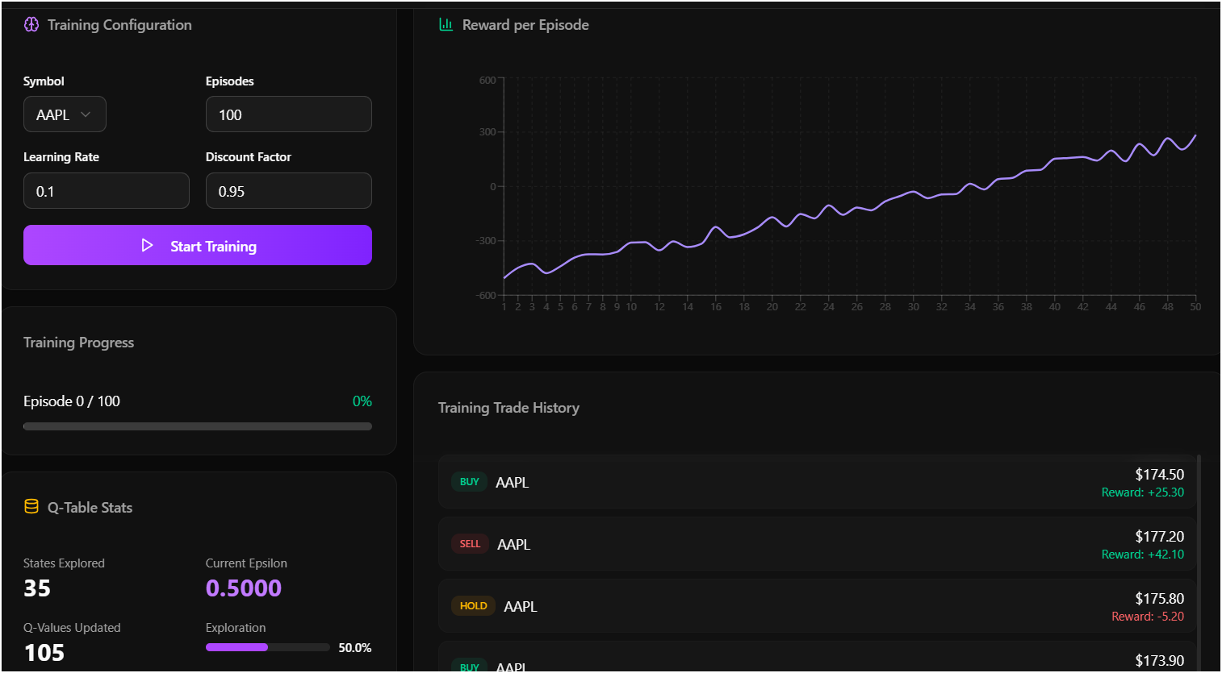
AI & Machine Learning Model
Reinforcement Learning
Training Process
Prediction Mechanism

Slide 24

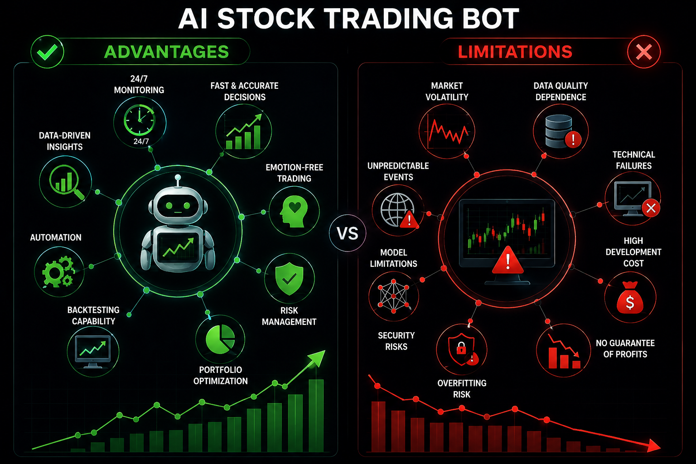

Advantages
Fast Decision Making
Emotion-Free Trading
Automated Analysis
Portfolio Optimization
Limitation
Market Uncertainty
Technical Risks
Data Dependency

Slide 25
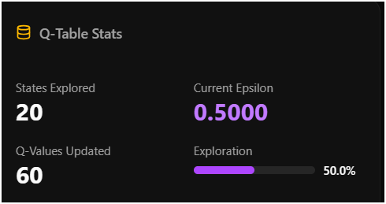
Future Enhancements
Real-Time Trading
News Sentiment Analysis
Advanced AI Models
Mobile Application

Slide 26

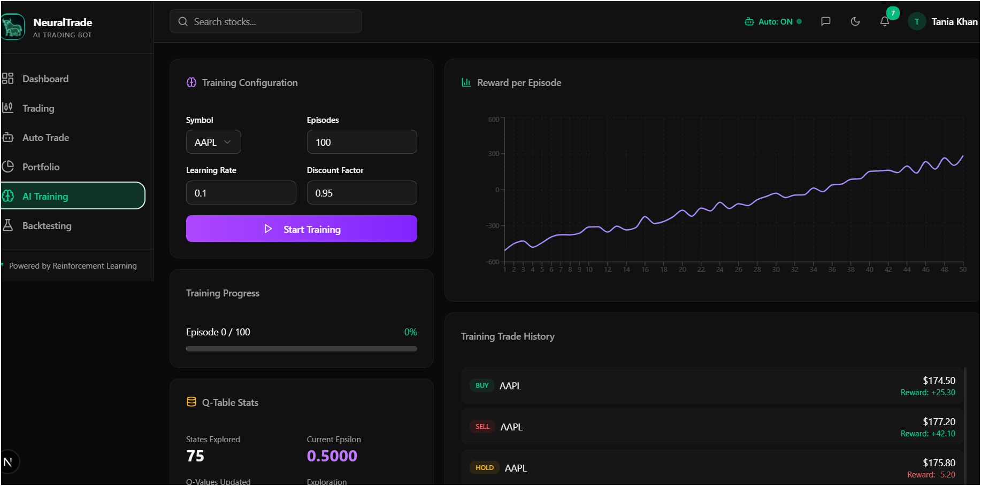
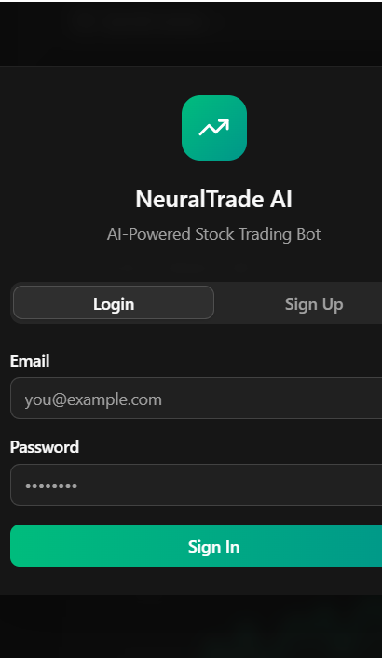
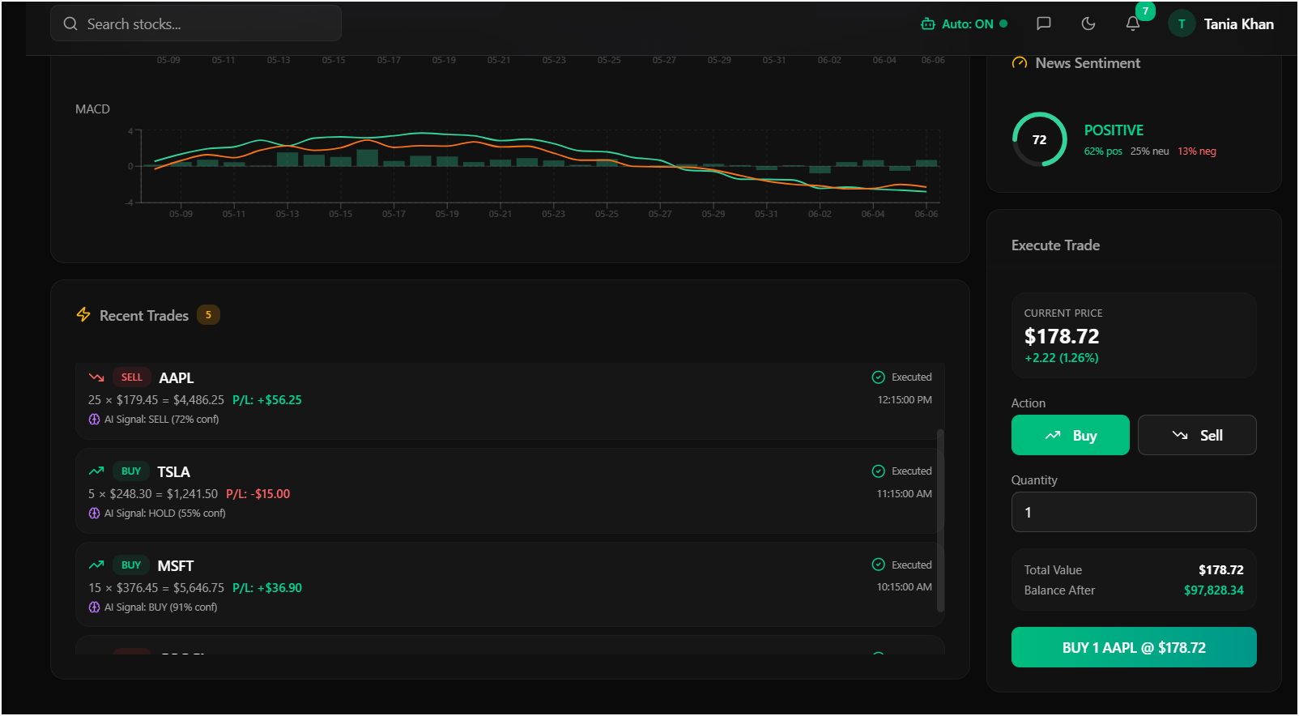
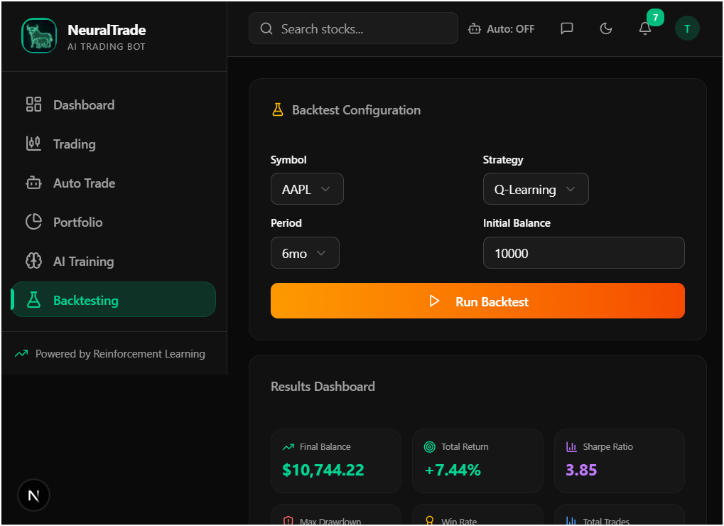
Results
The AI Stock Trading Bot successfully combines Artificial Intelligence, Reinforcement Learning, and Technical Analysis to assist users in making smarter, data-driven trading decisions while improving efficiency, accuracy, and user experience.

Slide 27

Conclusions
An AI Stock Trading Bot is a smart automated trading system that uses AI and market analysis to assist investors in making better trading decisions. It offers advantages such as speed, automation, and continuous monitoring, but it also faces challenges including market uncertainty, technical risks, and the inability to guarantee profits.

Slide 28



Thanks YOU!
"Thank you for your attention. Any questions I can answer? If they are too hard, I'll pretend my Wi-Fi cut out."

